Slide 1

Project presentation on Implementation of DFA accepting odd no. of a’s and/or even no. of b’s Presented By: Sonawane Vaishnavi.(36149) Sonawane Sunny.(36150) (Deogiri Institute Engineering and Management Studies) 2019-2020
MSP Mandal’s Deogiri Institute of Engineering and Management Studies Department of Computer Science & Engineering

Slide 2
Introduction
DFA=DFA is a deterministic finite automata which accept or send only one input to other state.
Problem – Construct a DFA machine over input alphabet = {a,b}, that accepts:
Odd number of a’s or even number of b’s
Odd number of a’s and even number of b’s
Either odd number of a’s or even number of b’s but not the both together
Solution – Let first design two separate machines for the two conditions:
Accepting only odd number of a’s
Accepting only even number of b’s
Then, merge these two and find the required final states.

Slide 3
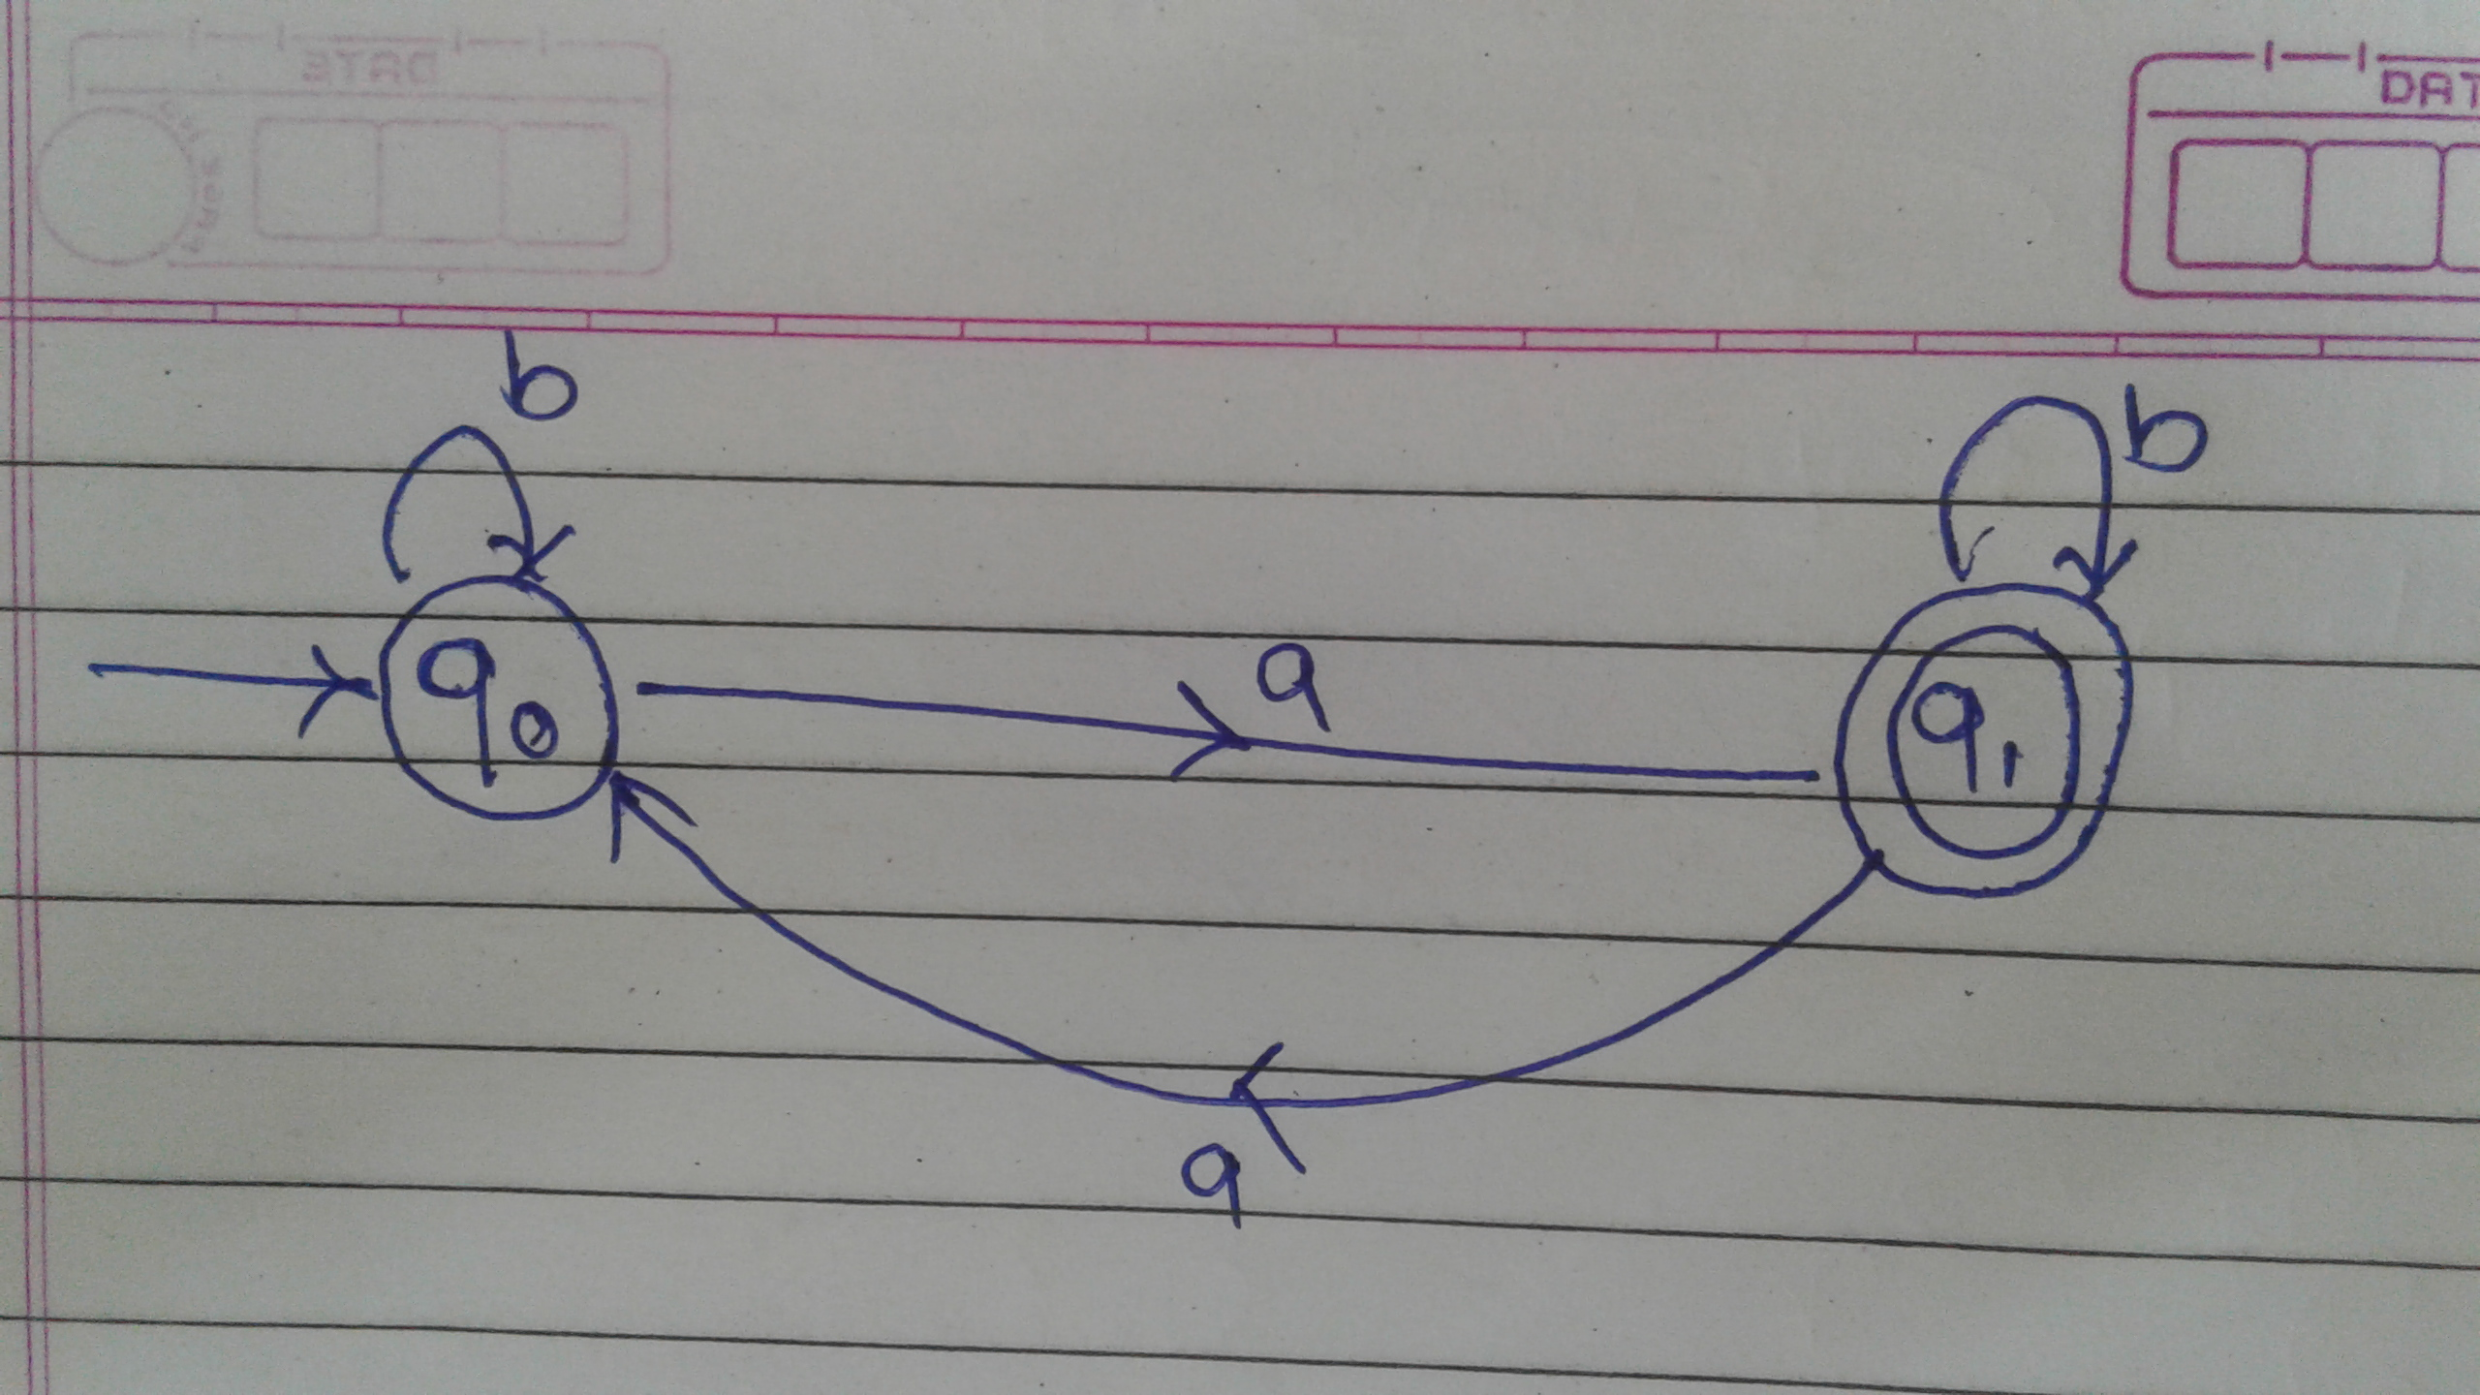
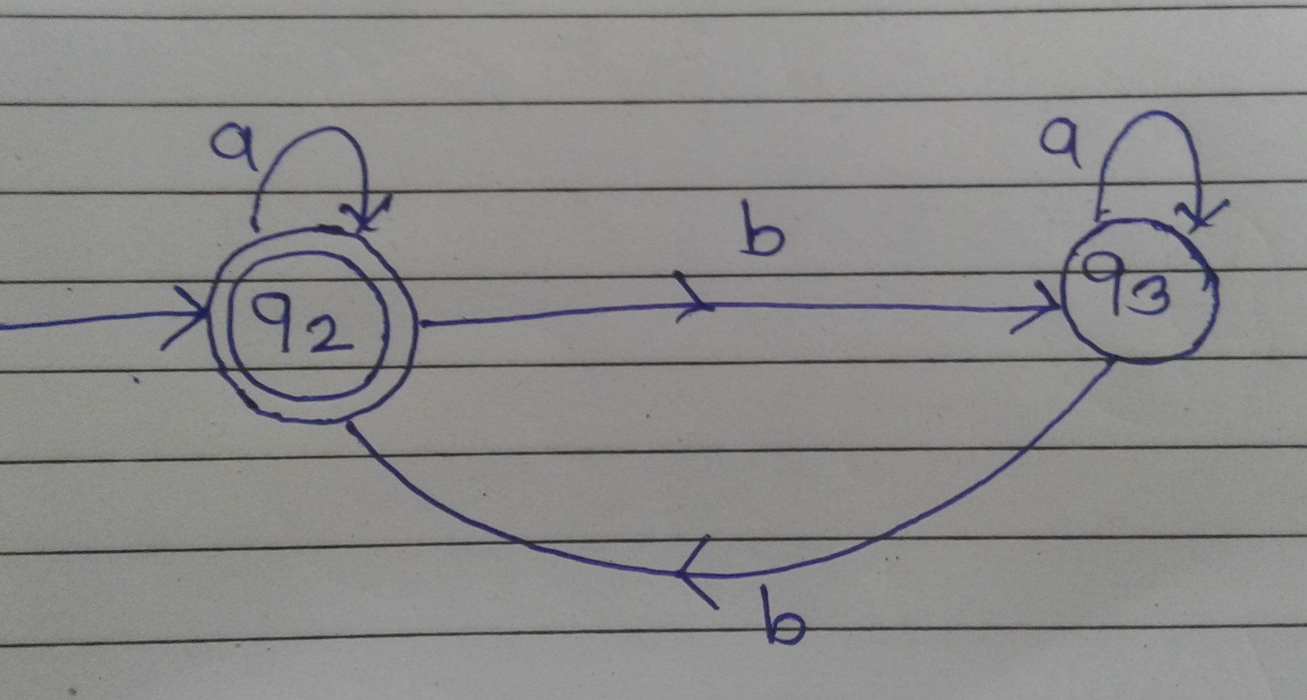
Figure

Slide 4
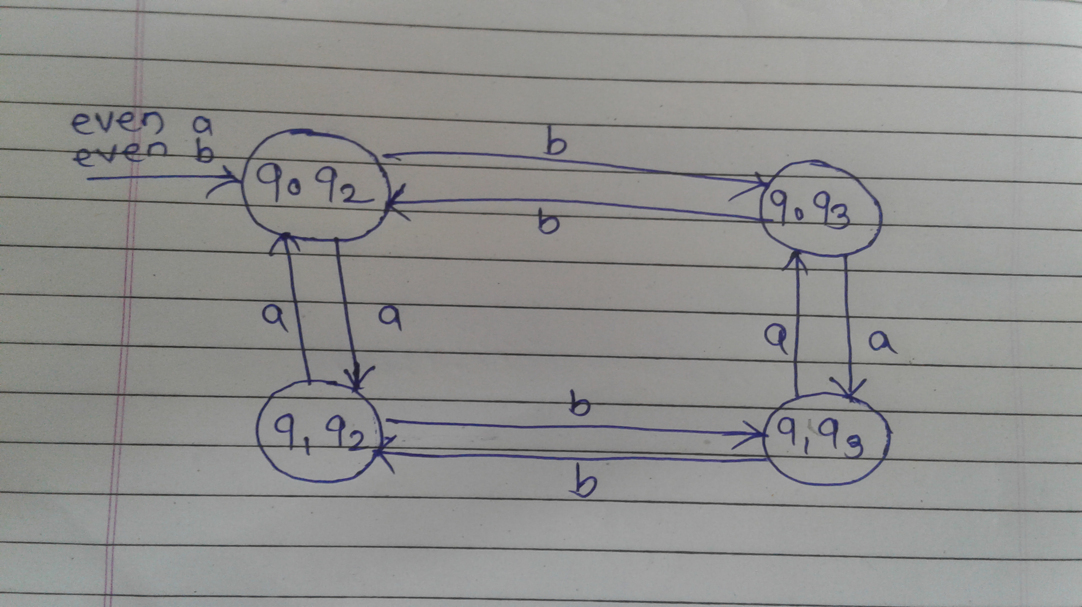
To merge these two machines, we will take the Cartesian product of the states of these two machines:

Slide 5
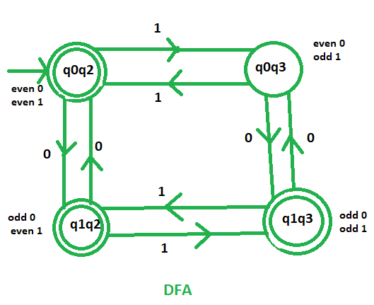
Subsolution1
Odd number of 0’s or even number of 1’s: This machine accept that languages which contains either odd no. of 0’s or even no. of 1’s. As we know that q1 indicates odd no. of 0’s and q2 indicates even no. of 1’s. So, the final states of the required DFA will contain either q1 or q2. .’. Final states = {(q0q2), (q1q2), (q1q3)}

Slide 6
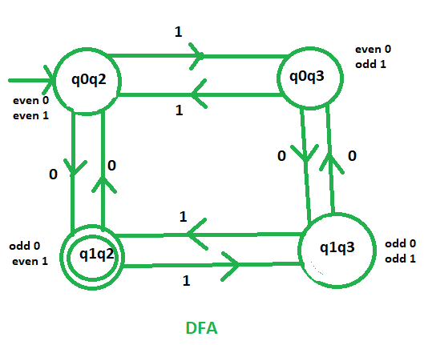
Subsolution2
Odd number of 0’s and even number of 1’s: This machine accept that languages which contains odd no. of 0’s and even no. of 1’s. As we know that q1 indicates odd no. of 0’s and q2 indicates even no. of 1’s. So, the final states of the required DFA will contain both q1 and q2. .’. Final state = {(q1q2)}

Slide 7
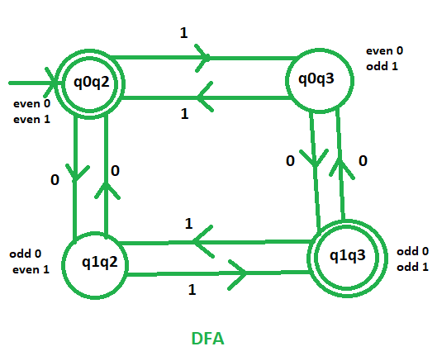
Subsolution3
Either odd number of 0’s or even number of 1’s but not the both together: This machine accept that languages which contains either odd no. of 0’s or even no. of 1’s but not that languages which contains both odd no. of 0’s and even no. of 1’s. As we know that q1 indicates odd no. of 0’s and q2 indicates even no. of 1’s. So, the final states of the required DFA will contain exactly one among q1 and q2. .’. Final states = {(q0q2), (q1q3)}

Slide 8
Algorithm
1.Enter string to check it’s acceptance.
2.Count no. of a’s and b’s in string.(i.e.counta,countb)
3.Check condition
if(counta%2!=0||countb%2==0)||(counta%2!=0 && countb%2==0)||(counta%2!=0)||(countb%2==0)
{return “string is accepted”
}
Else{
Return “string is not accepted”
}

Slide 9
Application
Vending machines
Traffic lights
Video text
Text parsing
Natural language processing

Slide 10
Thank you!!!!

